Slide 1




Tech Backbone of India’s Vaccination Program

Slide 2






India – A Perspective
Rural : Urban
65 : 35
Population
1.36 Billion
Male: Female
1000 : 943
Low internet & mobile density
Tribal Population
100:8.6

Slide 3
















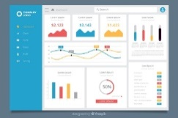
COVID -19 Vaccine Delivery Management System
Government Medical Store Depot (GMSD)
Vaccine Storage & Transport at
28,934 Cold Chain points
State Vaccine Store
Refrigerated/ Insulated Van
District Vaccine Store
Refrigerated/ Insulated Van
Primary Health Centre
Manufacturer
Air Transport
Real Time tracking of Stock and Temperature
through Electronic Vaccine Intelligence Network (eVIN)
Planning & Conducting Vaccination
COVID Vaccination Centre
Vaccine Carrier
Beneficiary Vaccination
Beneficiary Registration
Session Planning
Real time recording of Vaccination event using Co-WIN
Beneficiary acknowledgement
Unique Health ID
QR Code based Certificate
AEFI Reporting
Dashboards & Reports

Slide 4


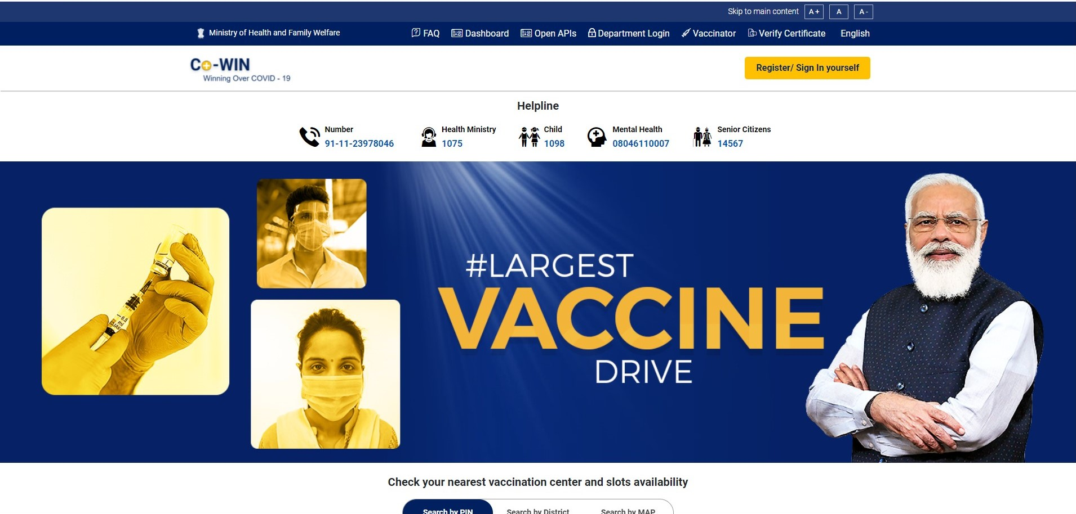


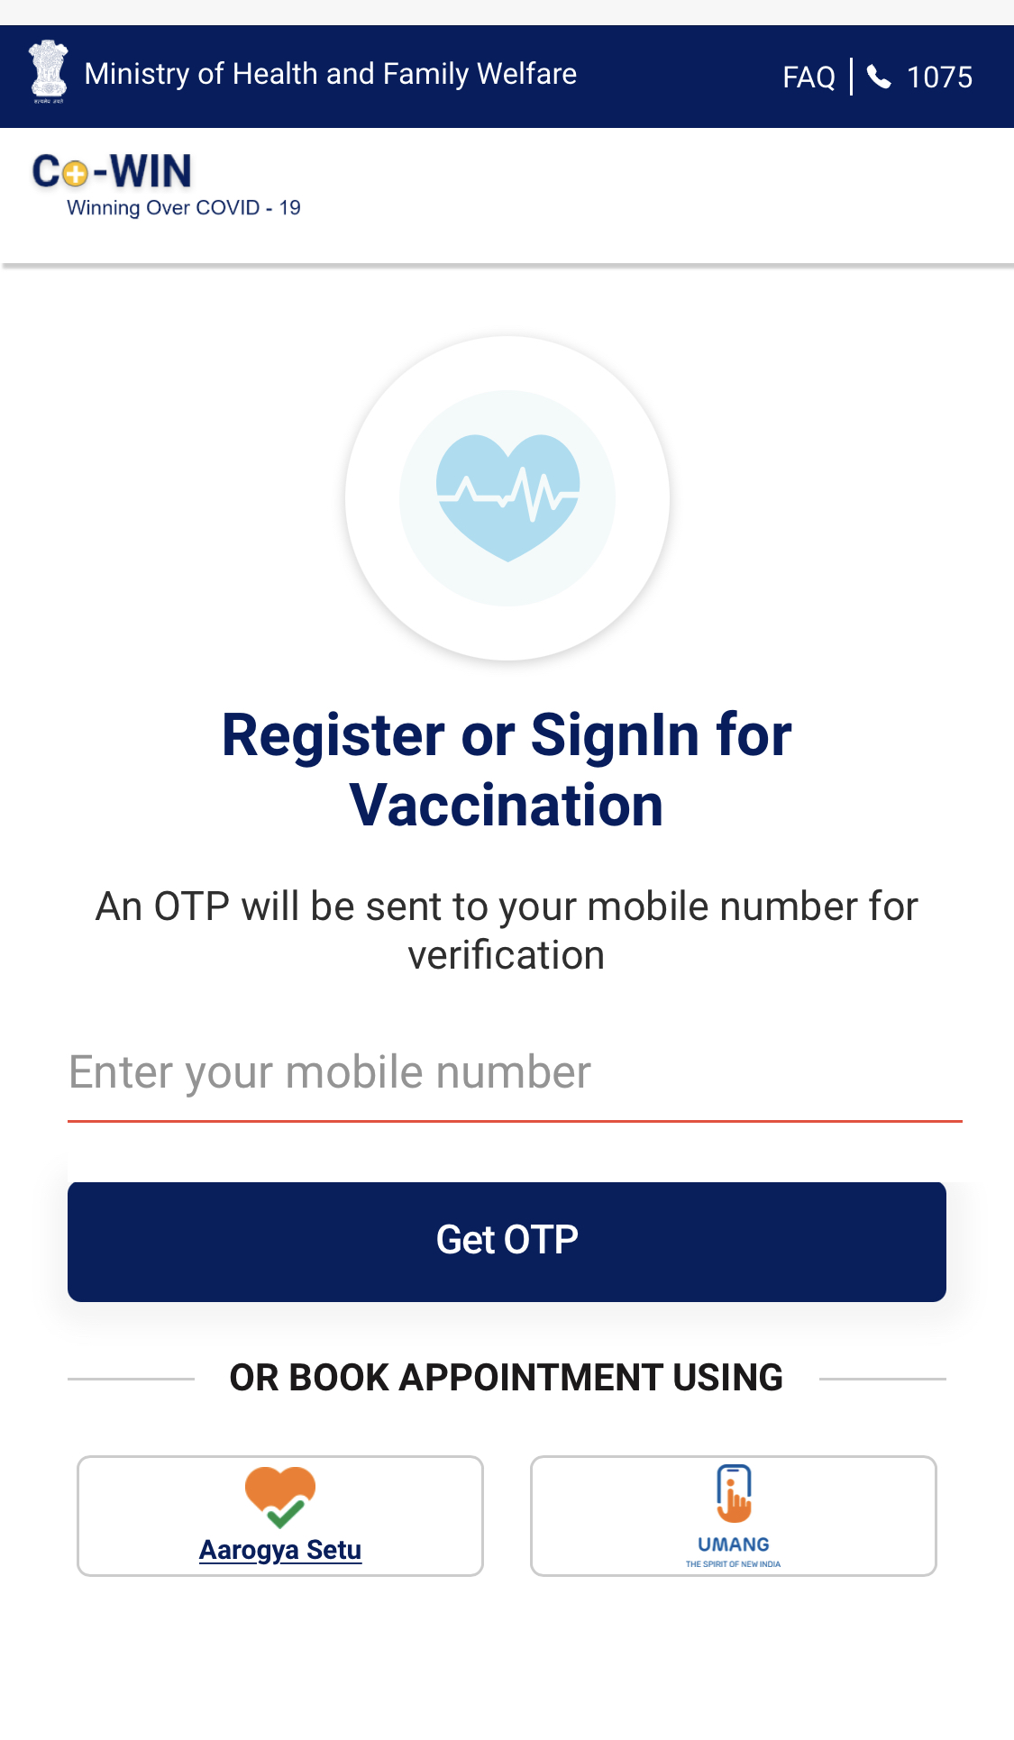


Co-WIN – A Scalable, Inclusive and Open Platform for Universal Vaccination by 2022
Guiding Principles
Equitable and Inclusive
Equitable vaccination across multilingual states, with multiple modes for registration to ensure accessibility for all
Single Source of Truth
Unbiased distribution of vaccines through a single source of data to remove information asymmetry and align stakeholders
Evolvability and Scalability
Dynamic architecture capable of evolving and accommodating changes as per circumstances, built for a scale of a billion plus citizens
Covid Vaccine Intelligence Network
A tech-based platform facilitating the planning, implementation, monitoring, and evaluation of Covid-19 vaccination in India
Feedback and Analysis
Data on vaccination and recording of AEFI helps form data-driven public health policy and evaluate the efficacy of different vaccines

Slide 5




Architecture of Co-WIN – Open and interoperable
Application Service Providers
Portal
Registration & Scheduling Module
Vaccination Facility Module
Vaccination Module
Certification Module
3rd Party Apps allowed to build above these APIs
Connected via
Protected APIs
Registration
Facility
Vaccination
Certificate
3rd Party Apps
Co-WIN Database

Slide 6



Open APIs – Interoperability that enables innovation
Multiple Access Points
Registration and Scheduling APIs
Provide more fronts to let citizens register for vaccination
Discover available vaccination slots and schedule or re-schedule appointments
Vaccination at Facilities APIs
Government and Private Hospitals can integrate these APIs with existing systems
Record vaccination data for certification
Report AEFI for a beneficiary
Certification APIs
Travel or office portals can gain integrate these APIs with their user-facing platforms
Access vaccination certificates based on a reference id / registered mobile number

Slide 7

For the Citizens

Slide 8







Advantages for Citizens – Agency at the core, luxury of choice
Core Functionalities
Modes of Registration
Offline on-site registration
Online registrations through portal
Assisted registration through support centres and call-centres
Blended Registration
Digital & Offline Walk-ins
Mobile # | Choose from 9 Photo IDs
Track Vaccination Schedule
Guidance on interval between two doses based on vaccine brand
Simplified Access
Find vaccination centre using maps
Sign-up with mobile number and verify with a four-digit OTP
Multilingual – Power of vernacular
Convenience in Slot Booking
Choose vaccination slot based on convenient time and location
Minimal Data Inputs
Non-sensitive data inputs
Required - Name, age & gender
Multiple photo identification options
Monosyllabic / single-word prompts
Instant Digital Certificate
Issued post vaccination
Universally authenticable

Slide 9
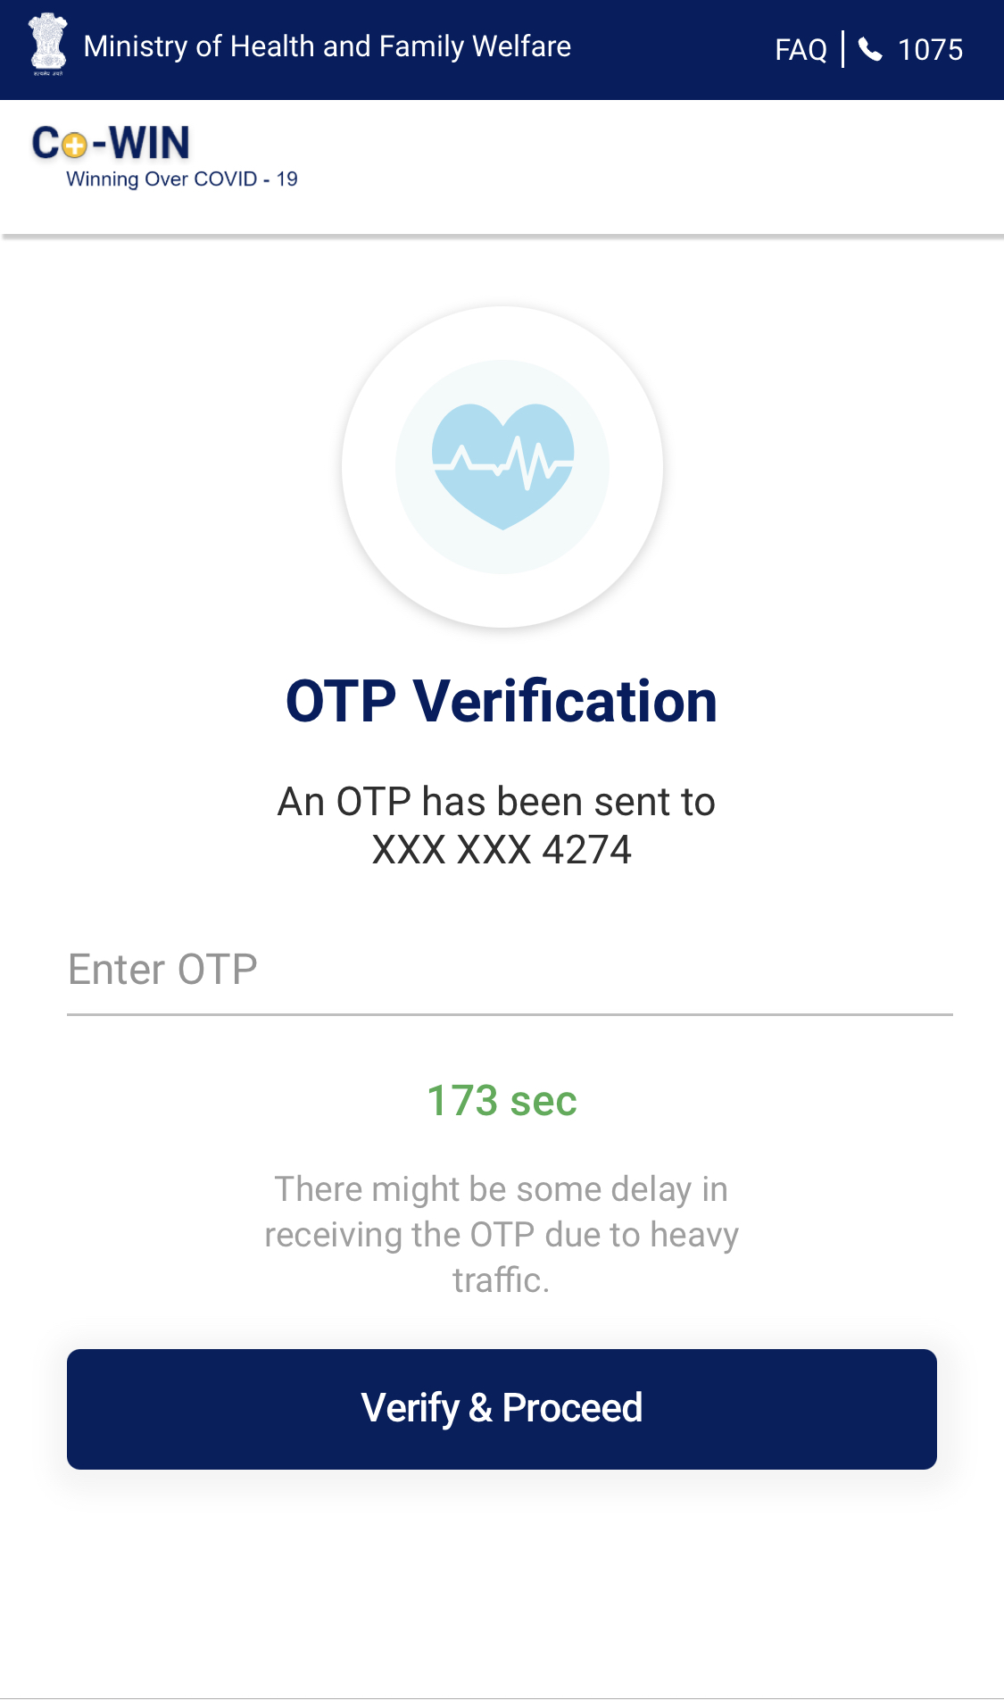
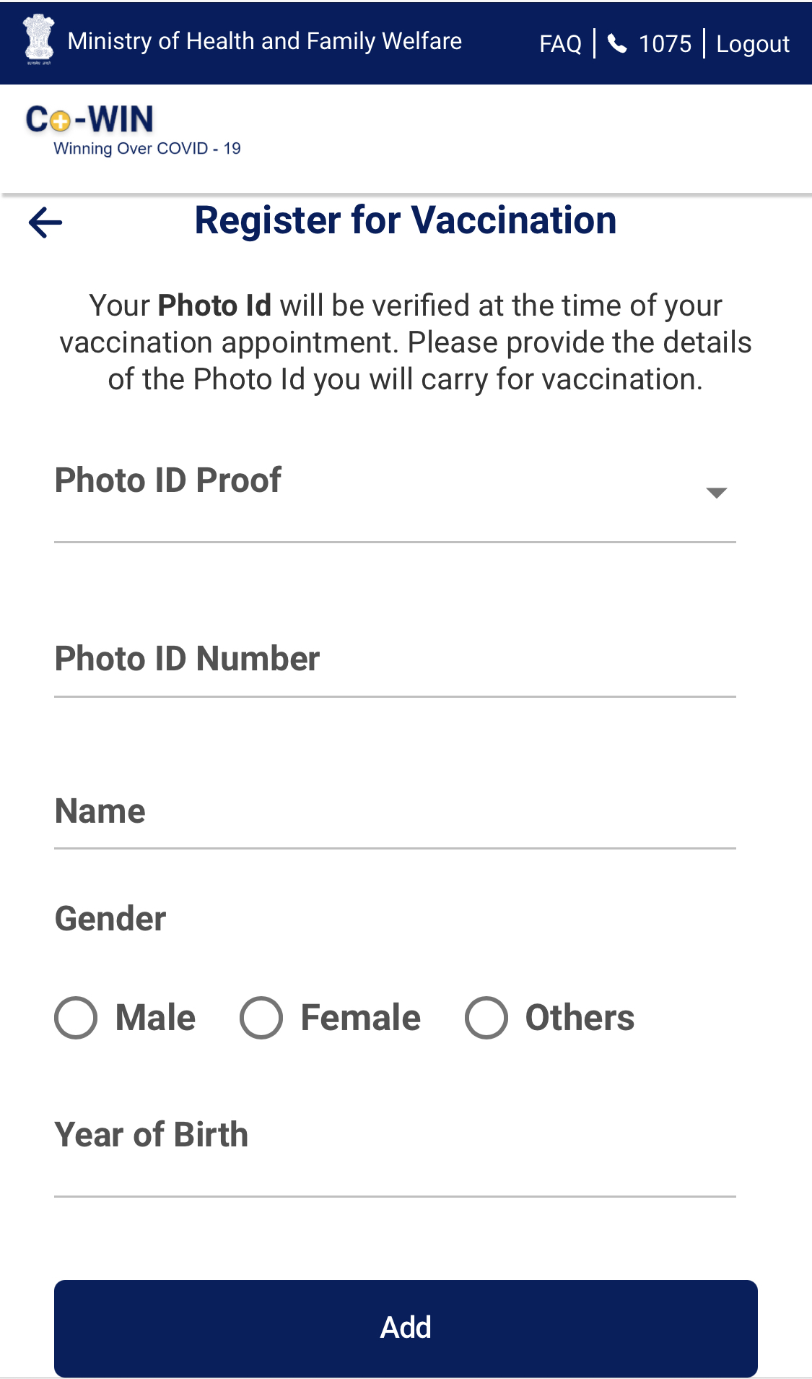
Easy Registration – Option of 9 photo IDs and 12 languages

Slide 10
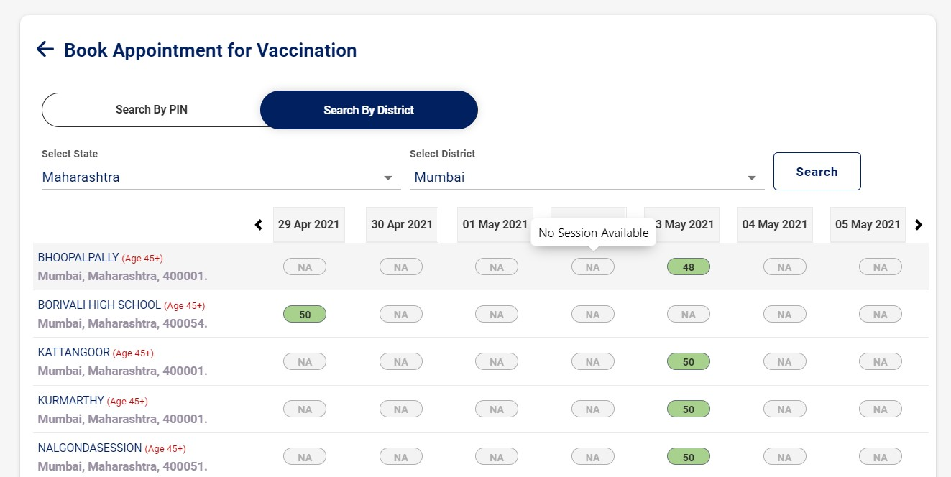
Choice of Time and Location – Book a vaccination slot as per convenience

Slide 11
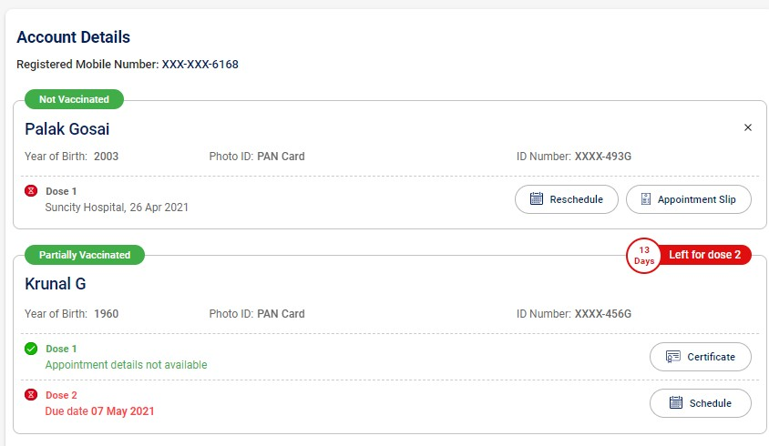
Tracking Vaccination – Book for up to 4 individuals, check schedule & download certificate

Slide 12

For the Managers & Vaccinators

Slide 13










Advantages for Managers – Uniform access across private and public, fixed or mobile
Process Flow
Features for Vaccinators
Login
Vaccine Stock Management
Verify validity of stock supplied
Traceability of each vial of vaccine
District Admin logs in with “User Id” and “Password”
Create new vaccination
facilities
Edit Existing Facility Details
Publishing Vaccine Schedules
Declare availability based on stock daily & define quotas for categories
Add new Vaccination Center details
Edit / Delete existing Facility details
Create new vaccination
Sessions
Edit existing Vaccination
Session
Verification of Citizens
Authenticate at point of vaccination Upload records of HCWs/ FLWs
Create new vaccination sessions
Edit, Delete existing vaccination session details
View all sessions for the
District
Update Vaccines for
Sessions of a Facility
Realtime Dashboards
Analytics provided to view all sessions at a vaccination facility
Details of all vaccination session happening in the District
Edit, Delete Vaccine details

Slide 14
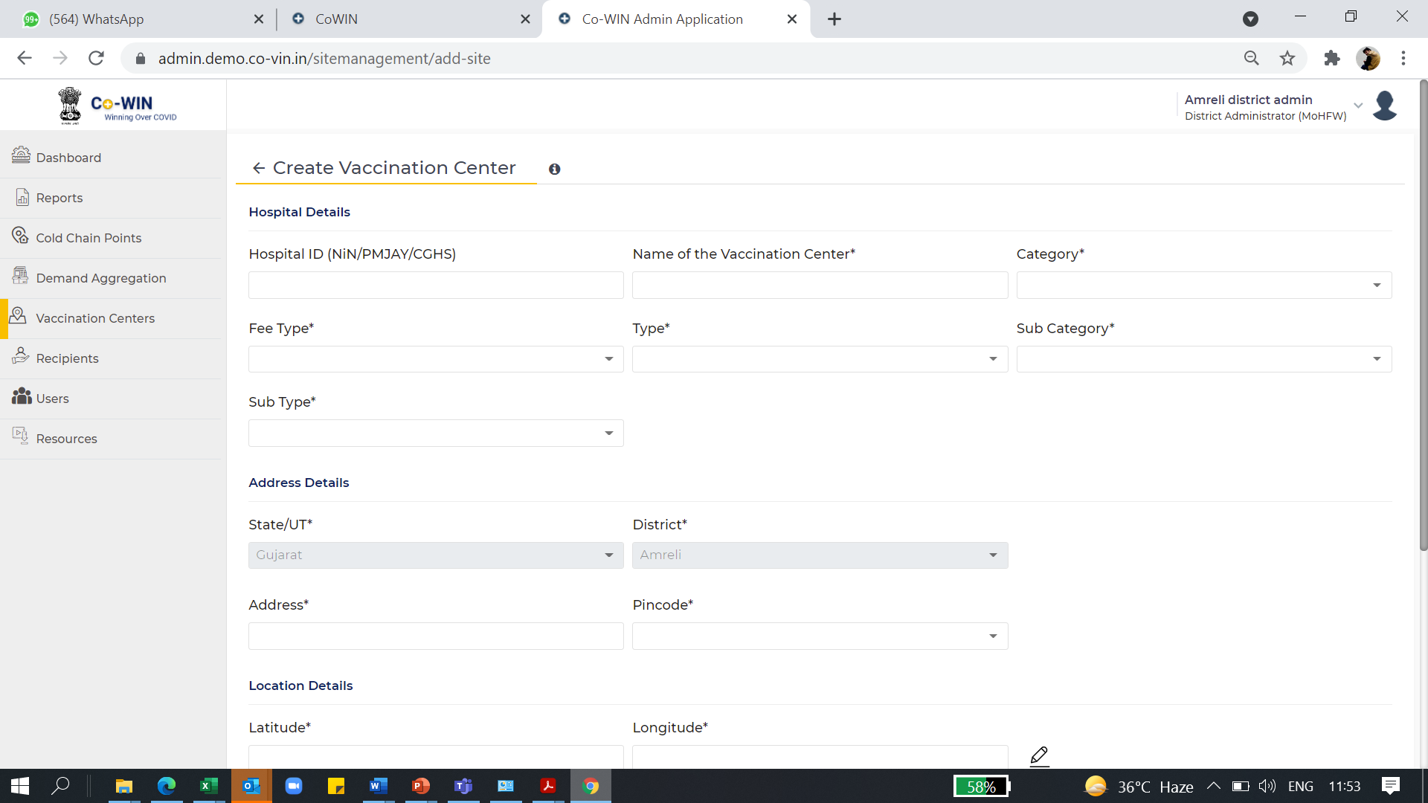
Onboarding Hospitals – Registering vaccinating organizations on CoWIN

Slide 15
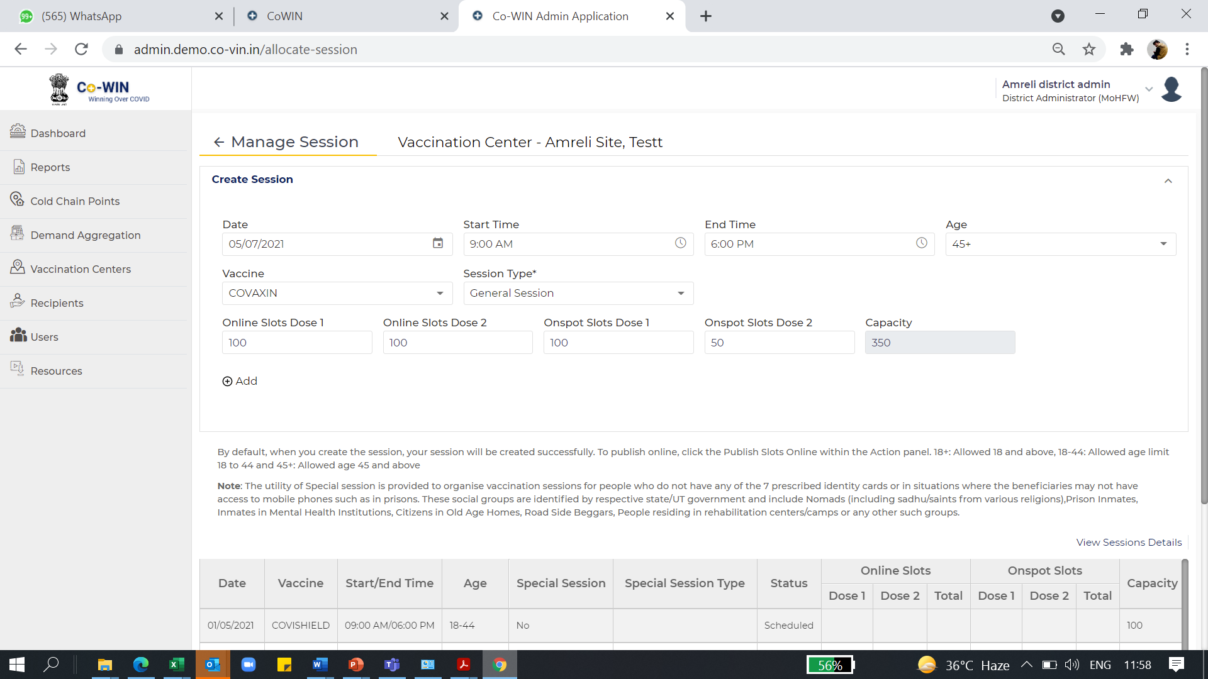
Session Management – Vaccination control, based on both vaccines & categories

Slide 16
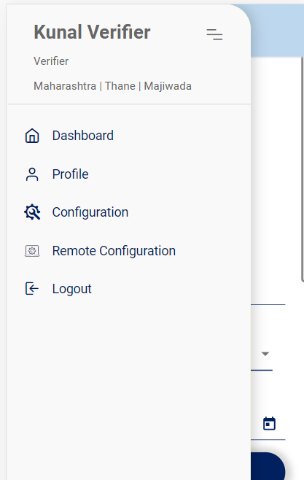
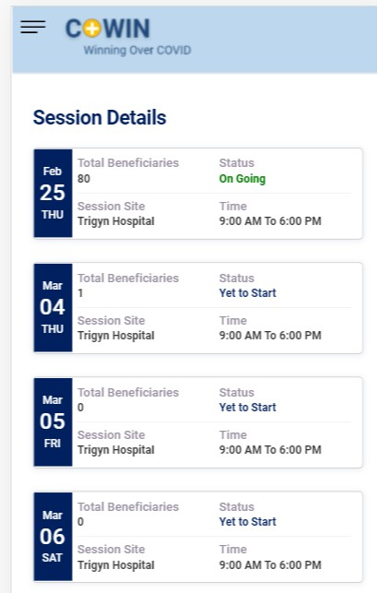
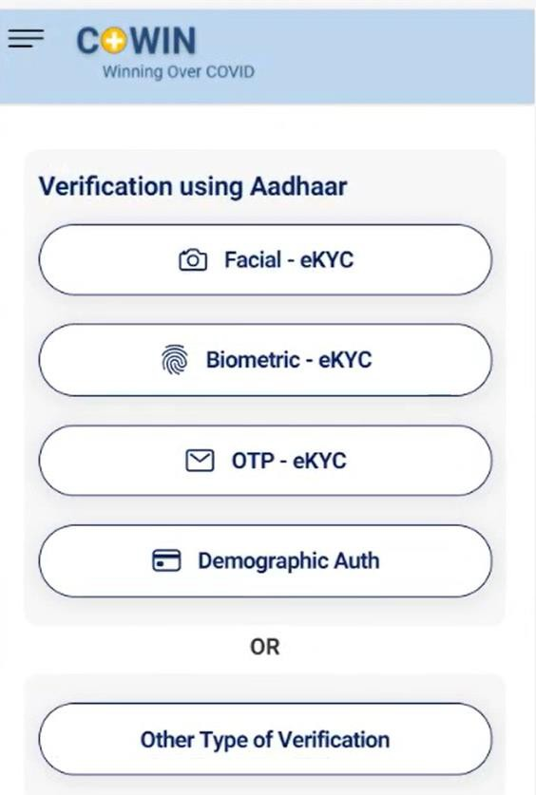
Mobile Access for Vaccinators – Plug and play solution for Vaccinators

Slide 17

For the Policy Makers
and Administrators

Slide 18



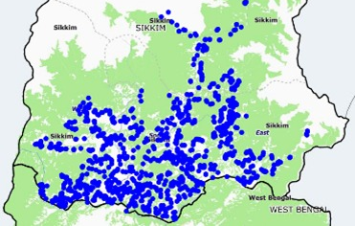
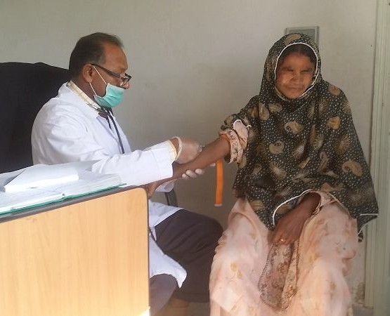
Advantages for Policy Makers – No information asymmetry and alignment of departments
Single Source of Truth
Aligns all stakeholders to prevent any form of rent-seeking and truly making each stakeholder accountable for their actions
Tracking AEFI for Vaccines
Allows recording of AEFI to form data-driven public health policy and evaluate the efficacy of different vaccines
Efficient Tracking of Certificates
Providing a reference point post first dose to guide citizens to follow the vaccination schedule and get the same second dose as first
Evaluating Geographical coverage
Facilitates coverage at a granular geographical level that helps get a view of each district at a state level to evaluate progress of vaccination
Inclusivity
Multiple modes of registration in offline walk-ins, online and assisted through help centres and call centres ensure access for all

Slide 19
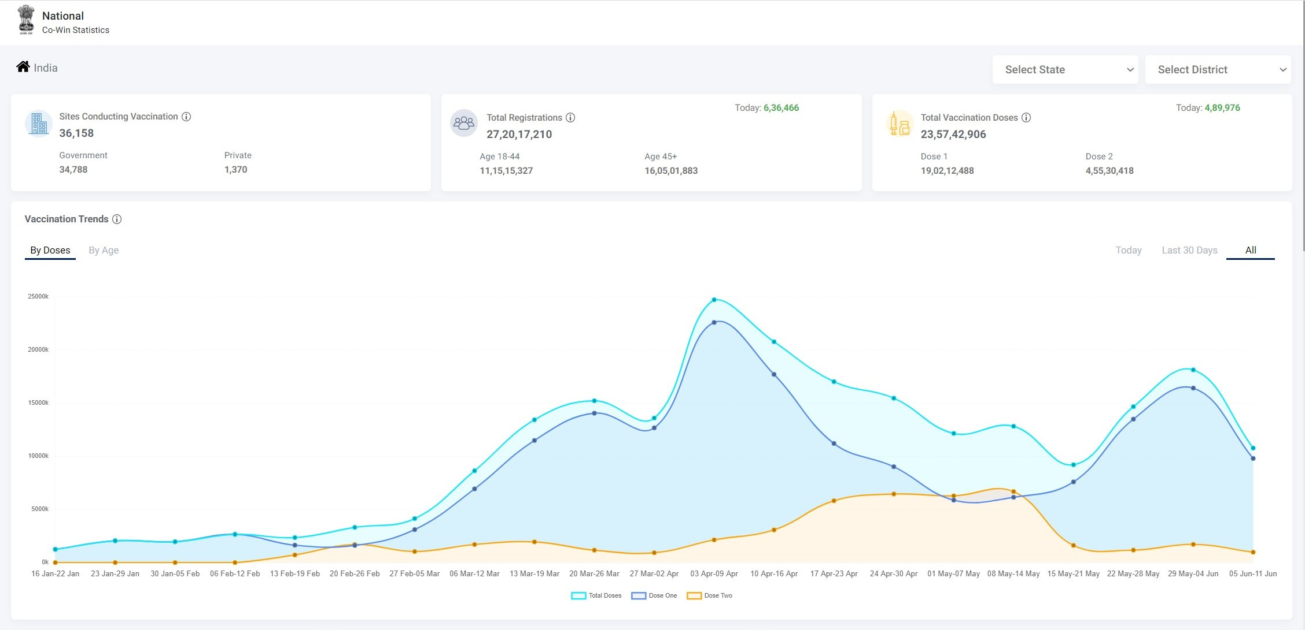
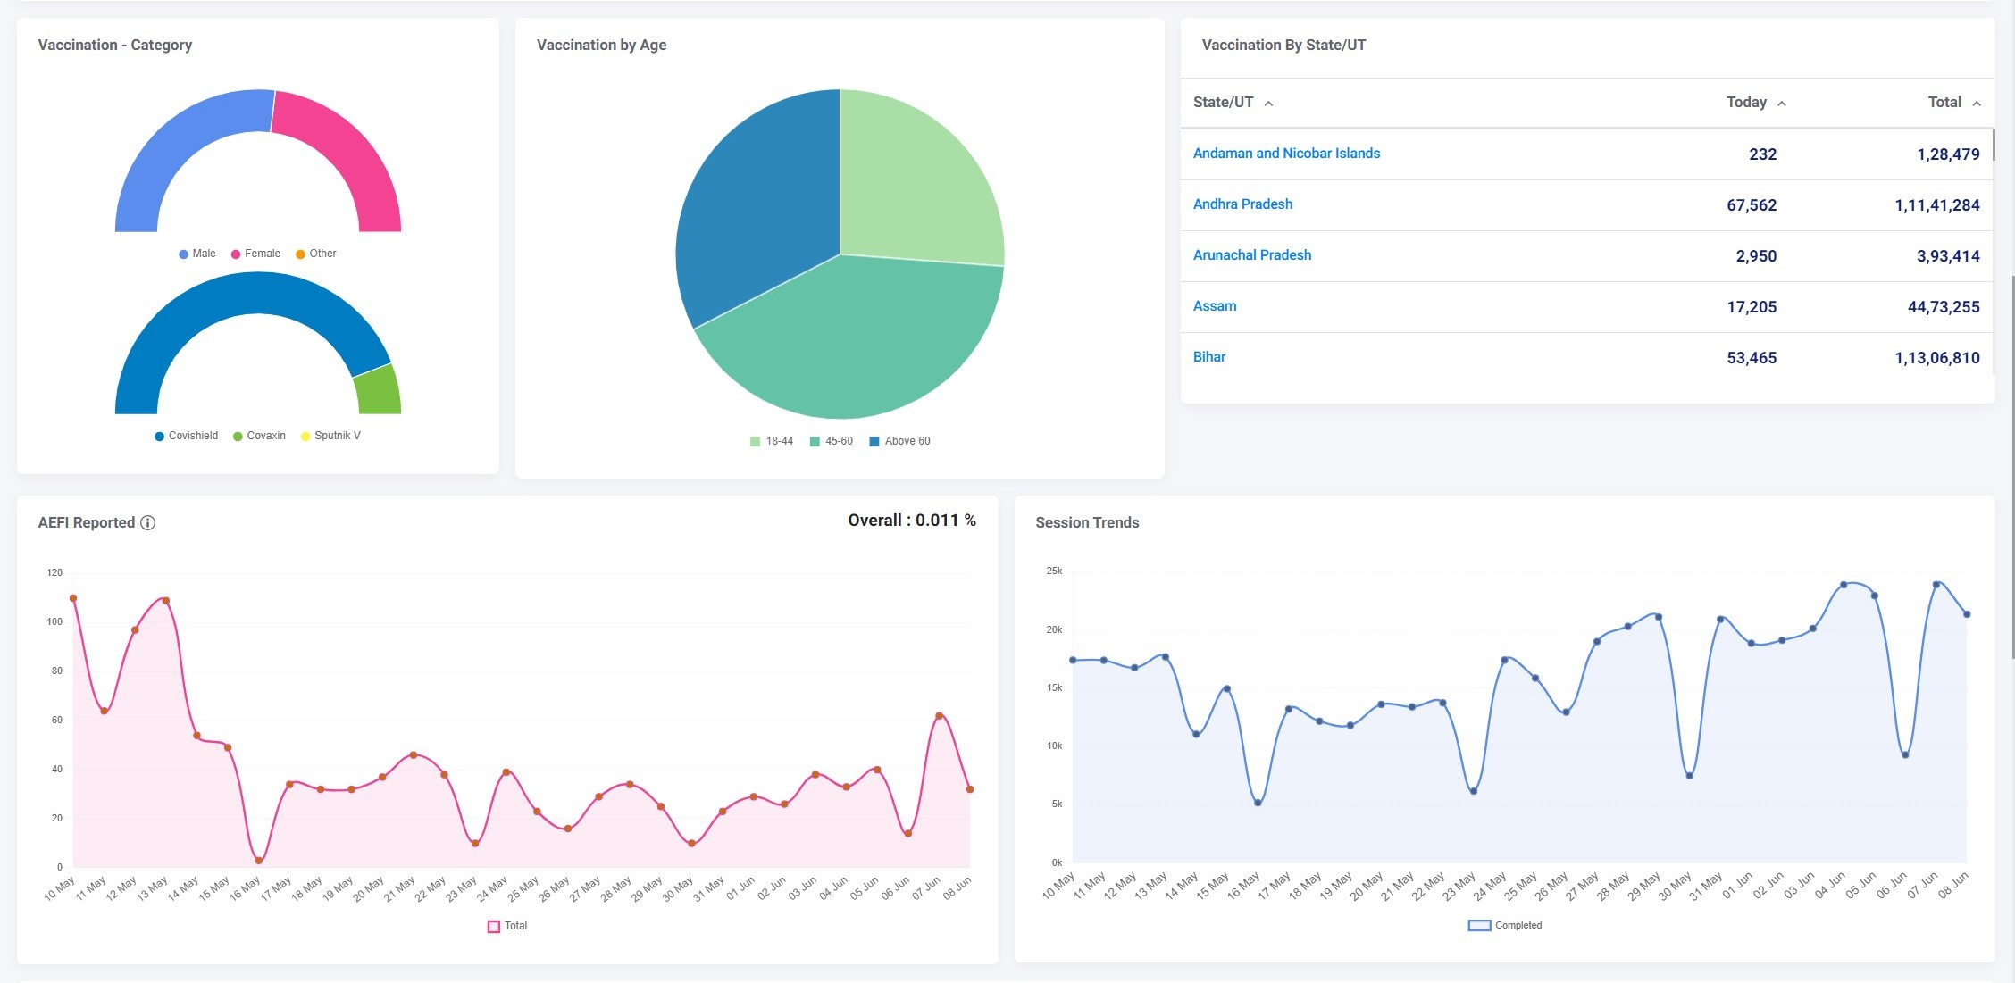



CoWIN Dashboard – Transparency of data for all stakeholders
Features provided by Dashboard
Live Vaccinations Centres
# of Citizens Registered
# of Vaccine doses Administered
Split b/w 1st & 2nd Dose
AEFI reports
Distribution by States & District
Split by Age and Gender
Split by Vaccines brands
Accessible by all
Hospitals
Vaccinators
Policy Makers
State & District Administrators
All Citizens and foreign entities
Live Co-WIN Dashboard - https://dashboard.cowin.gov.in/

Slide 20
National COVID-19 Vaccination Milestones
16th Jan’21
2nd Feb’21
1st Mar’21
1st Apr’21
1st May’21
Health Care Workers
Front Line Workers
Aged ≥60 years and 45 – 59 years with identified 20 co-morbidities
All persons aged ≥ 45 years
Persons aged 18 years & above
Phase-1
Phase-2
Phase-3
Phase 1 aim – To protect & strengthen the healthcare & pandemic response system and professionals who man it.
Phase 2 aim – To protect the most vulnerable population i.e. ≥ 45 years (contributing to 80% of COVID related mortality in the country).
Phase 3 aim – To protect the entire at risk population i.e. 18 years and above via a rapid scale up of vaccination

Slide 21
Vaccination Coverage in priority groups
(As on 2nd July’21)
2nd dose coverage against eligible beneficiaries i.e. 4 weeks after 1st dose of Covaxin and 12 weeks after 1st dose of Covishield

Slide 22
Co-WIN – Using technology to reach the unreached
Population
136 crore
~29.35 crore - at least one dose
Tribal Population (9%)
Coverage (doses/million)
100:122
Male: Female
1000 : 943
Coverage (doses)
1000 : 861
Availability of internet – No constraint
Coverage (Doses)
22:78 (Online : Onsite)
Rural : Urban
65 : 35
Coverage (doses)
57:43

Slide 23

Sustainability of Co-WIN – Fastest to be built, sustainable at scale of billion+ users
3.1B Hits
2.6B Hits
200 Million+ in 4 Months
Time to Market
Robust System
Privacy and Security
Fastest tech platform globally to amass 200 million registrations in <four months
Even tech giants took 14 months or more to even reach 100 million users
Co-WIN handles a billion+ visits daily, and recorded 3.1 billion visits in a day
Handled 13.7 million registrations within 8 hours of opening for 18 to 44 years
Minimal data inputs are taken from citizens, and no breaches of security recorded till date
State-of-the-art security checks in place

Slide 24
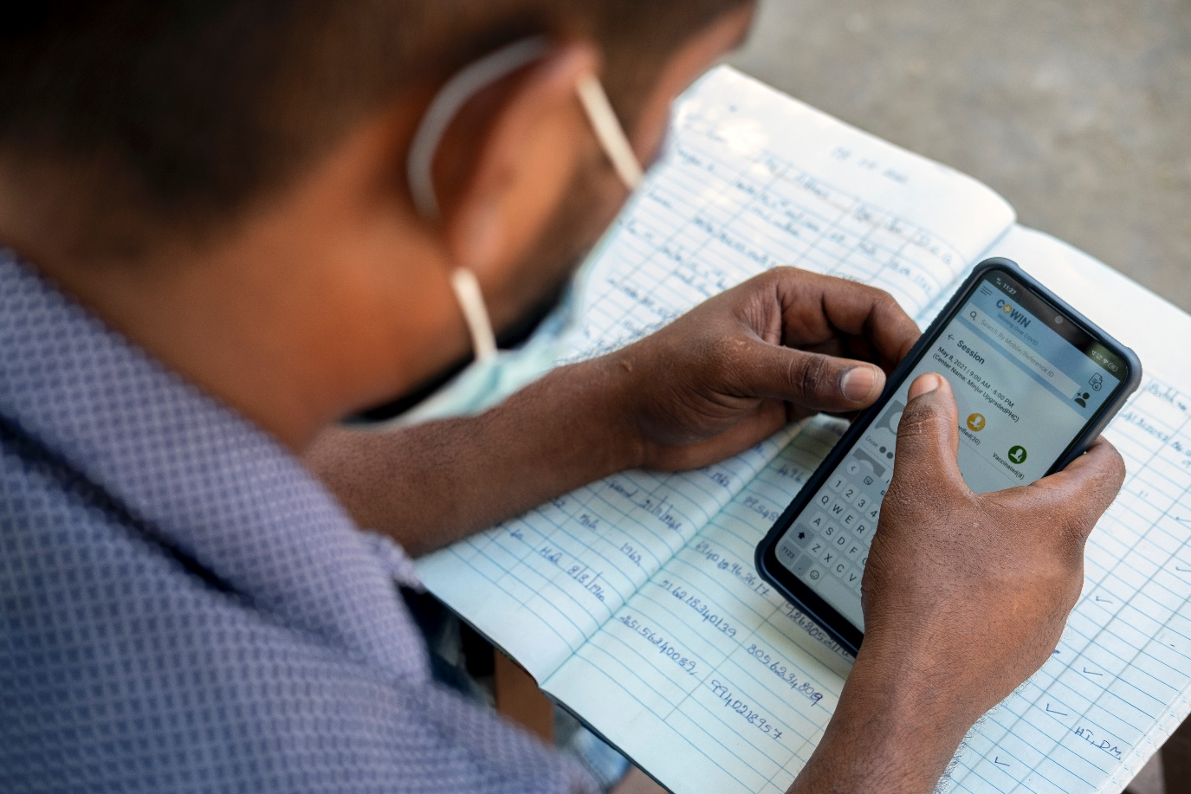
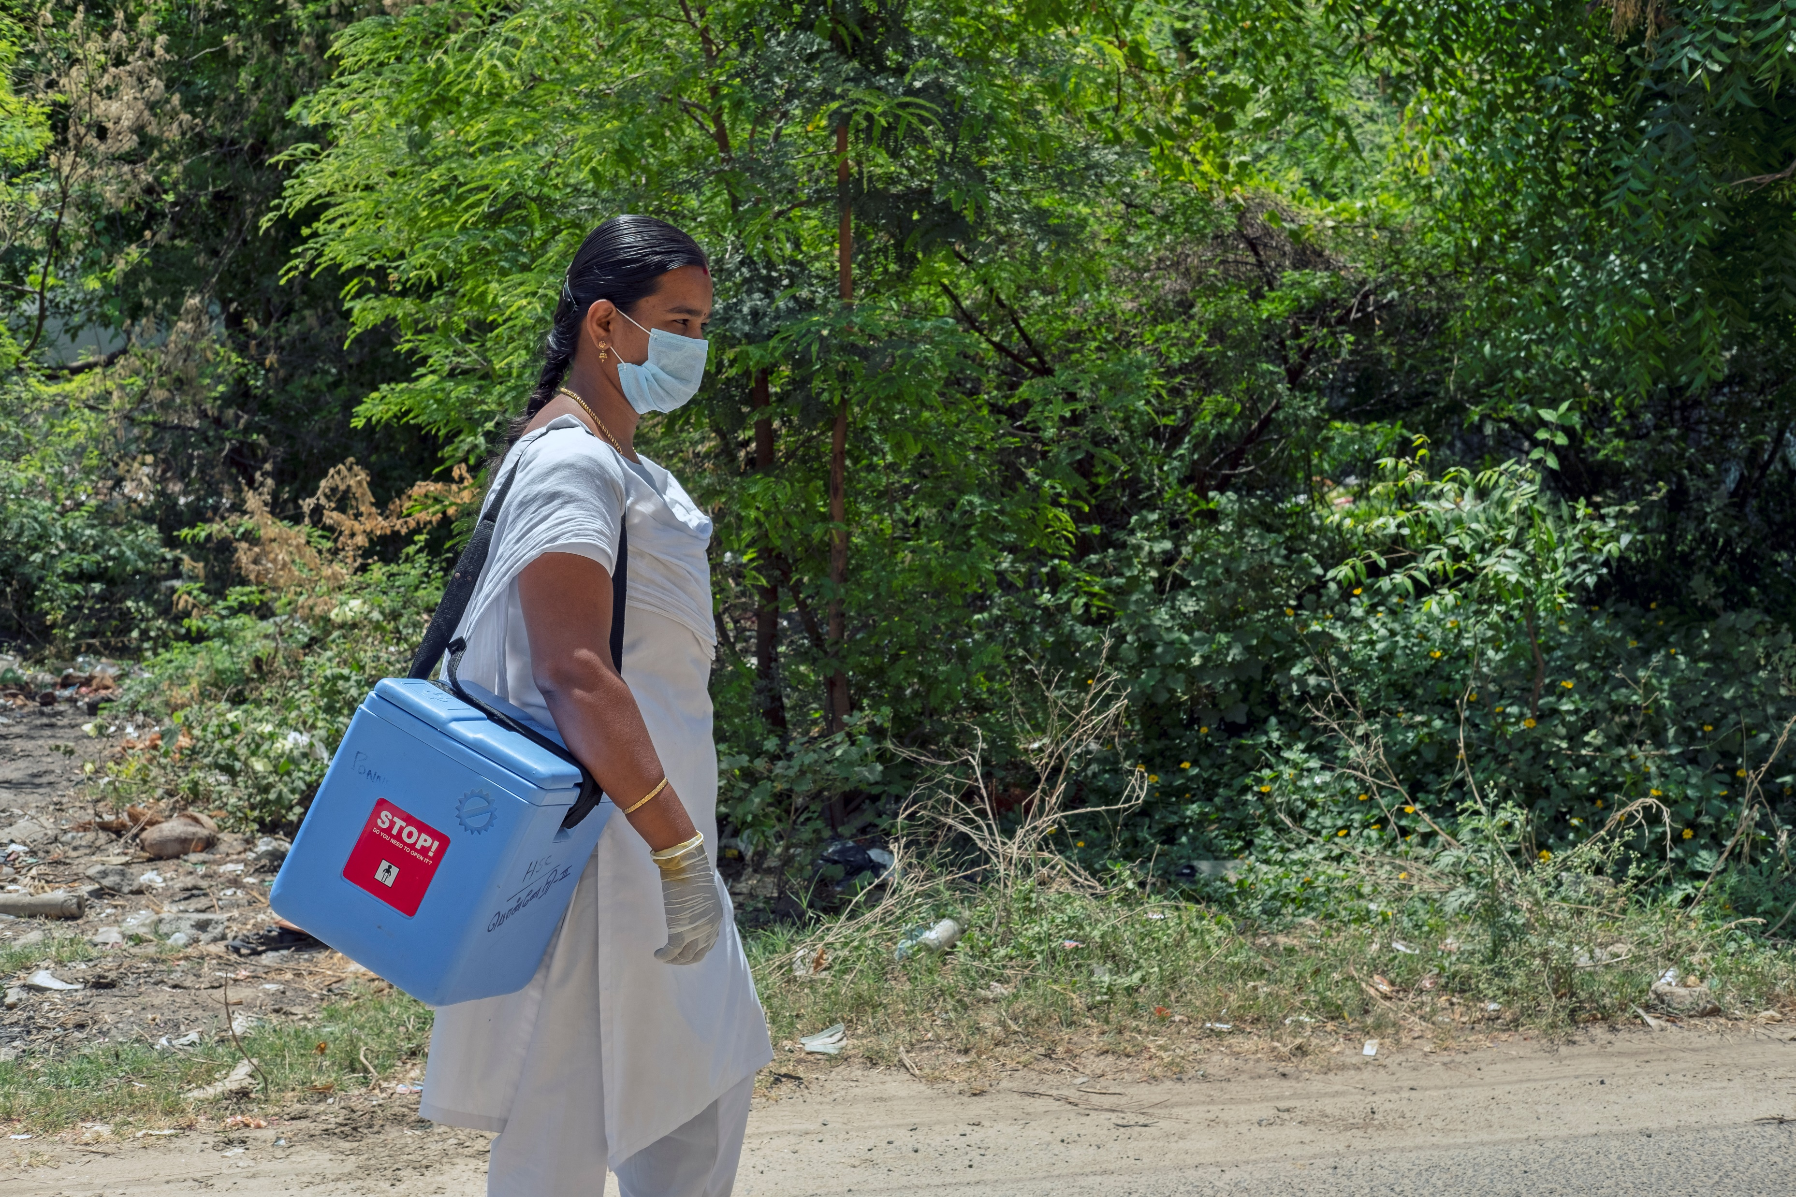

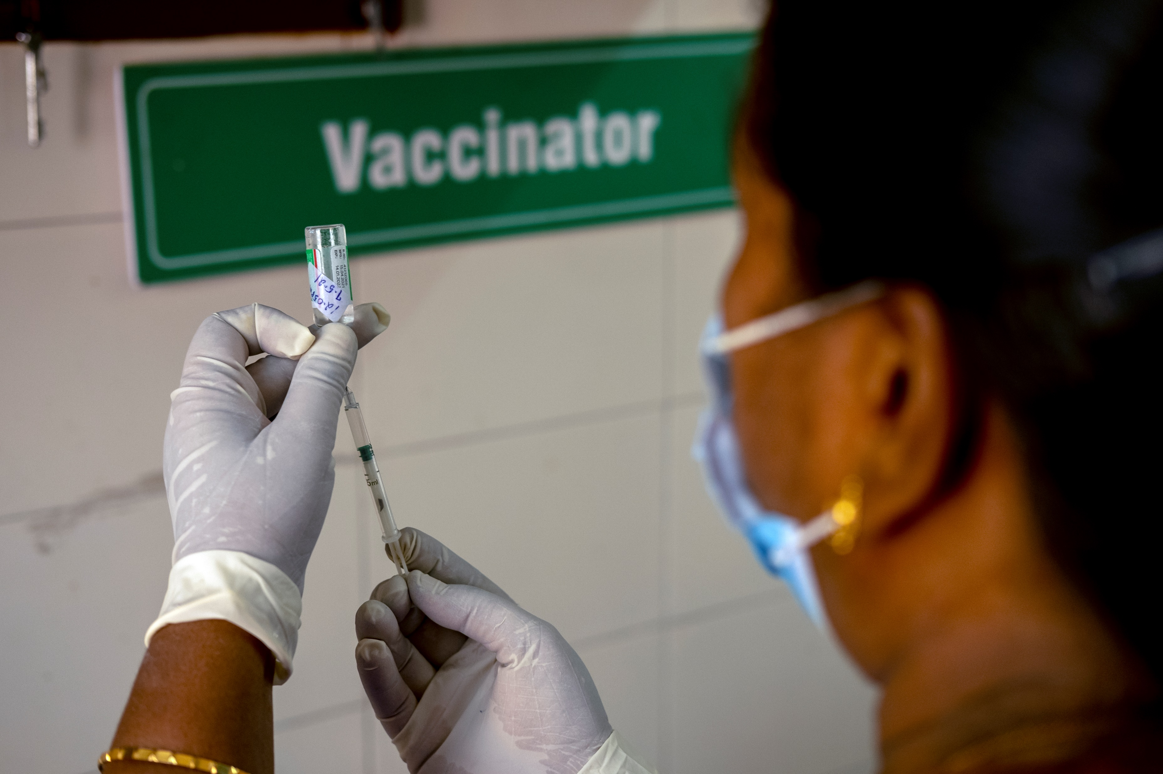
A BIG SALUTE AND THANKS TO OUR FRONTLINE WORKERS WHO OVERCAME ALL THE CHALLENGES TO MAKE INDIA THE FASTEST COUNTRY TO ADMINISTER MORE THAN 350 Million DOSES
#जज्ब़े को सलाम #शक्ति को प्रणाम

Slide 25




OUR PARTNERS

Slide 26

Thank You

